Slide 1
JAVA Lecture 13
Packages

Slide 2
What is a Java Package?
A collection of related classes and interfaces in Java.
Helps in grouping classes logically and avoiding naming conflicts.
Types of Packages:
✅ Built-in Packages → Provided by Java (e.g., java.util, java.io)
✅ User-defined Packages → Created by developers
Example:
java.util → Contains utility classes like ArrayList, HashMap
java.io → Contains input-output classes like File, BufferedReader

Slide 3
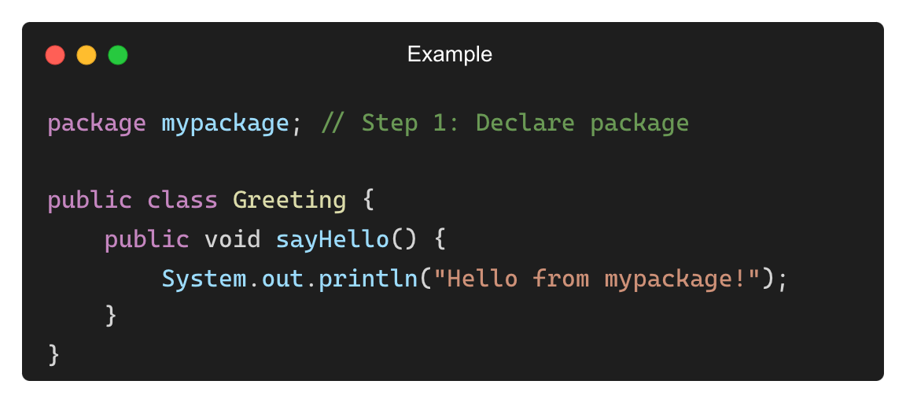
Creating a User-Defined Package
Steps to Create a Package:
1. Declare the package at the top of the Java file
2. Compile the file with -d option to specify the package location
3. Use the package in another class
• Example (Creating a Package mypackage):
• Compiling:
javac -d Greeting.java

Slide 4
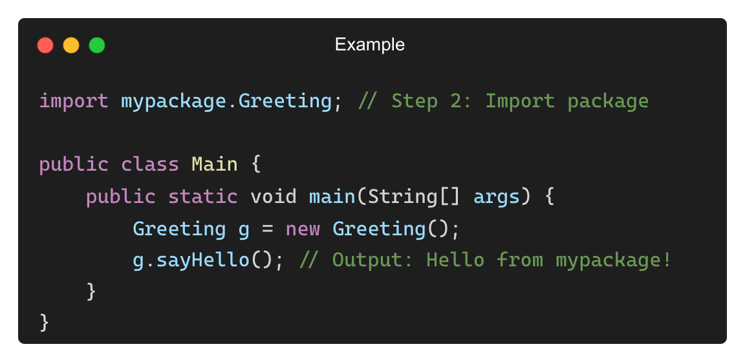
Using a User-Defined Package
To use a class from another package, import it using import keyword.
Example (Using Greeting class from mypackage):

Slide 5
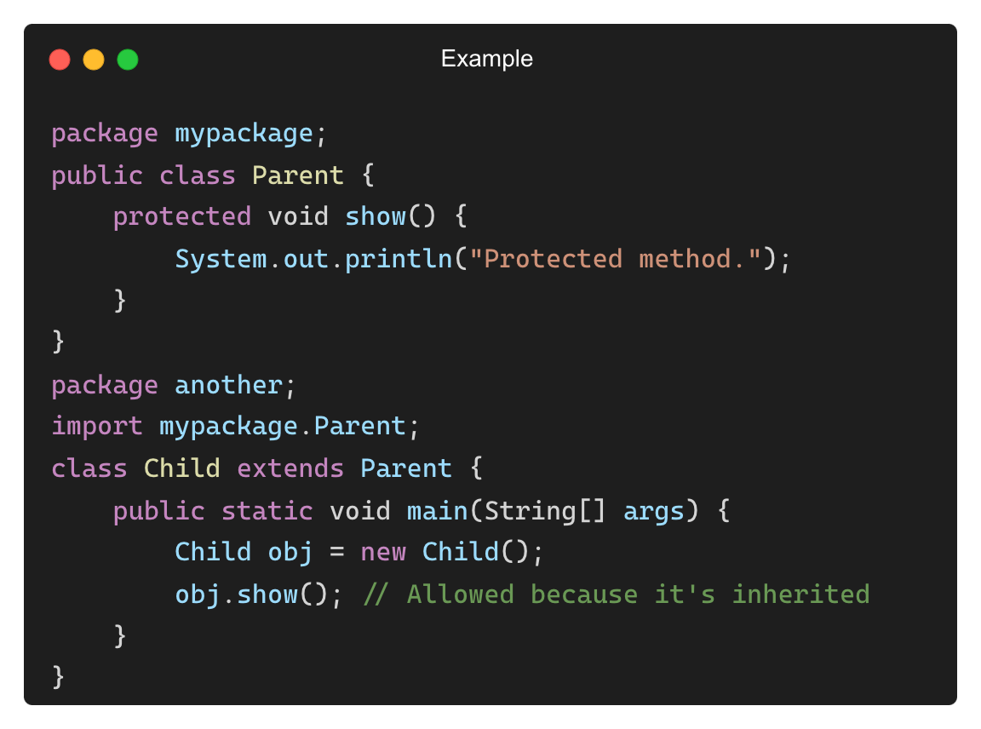
Default Access and Package Visibility
Java access modifiers control package visibility.
Modifier | Same Class | Same Package | Subclass (Different Package) | Other Packages
public | ✅ Yes | ✅ Yes | ✅ Yes | ✅ Yes
protected | ✅ Yes | ✅ Yes | ✅ Yes | ❌ No
default (no modifier) | ✅ Yes | ✅ Yes | ❌ No | ❌ No
private | ✅ Yes | ❌ No | ❌ No | ❌ No

Slide 6
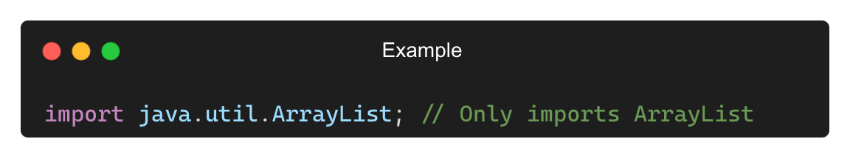
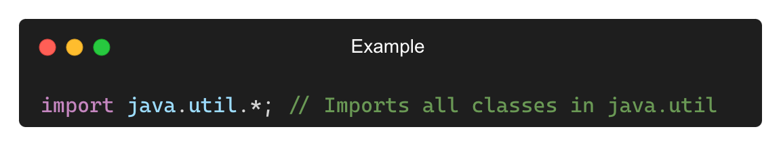
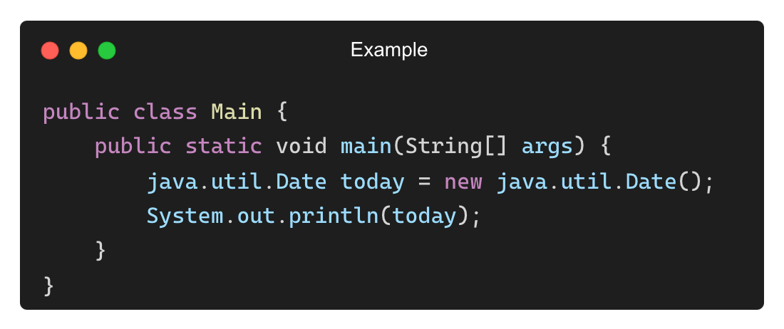
Importing Packages in Java
Importing a Single Class:
Importing an Entire Package:
Using Fully Qualified Name (Without import):

Slide 7
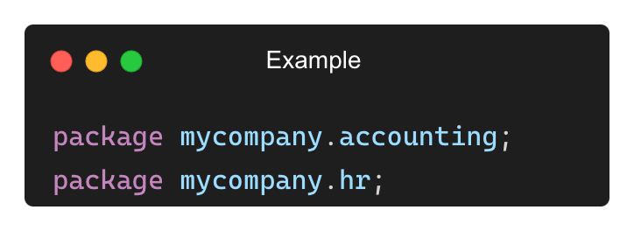
Benefits of Using Java Packages
✅ Code Organization → Keeps related classes together.
✅ Avoids Naming Conflicts → Two classes with the same name can exist in different packages.
✅ Access Protection → Controls class visibility using public, protected, etc.
✅ Easier Maintenance → Large projects are easier to manage.
Example (Avoiding Naming Conflicts):

Slide 8
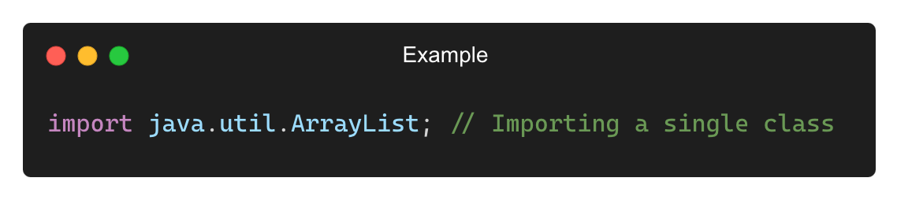
What is Importing in Java?
Importing allows a Java class to access another class or package without using fully qualified names.
Types of Imports in Java:
✅ Regular Import → Imports specific classes or entire packages.
✅ Static Import → Imports static members (methods/variables) of a class.
Example of a Regular Import:

Slide 9
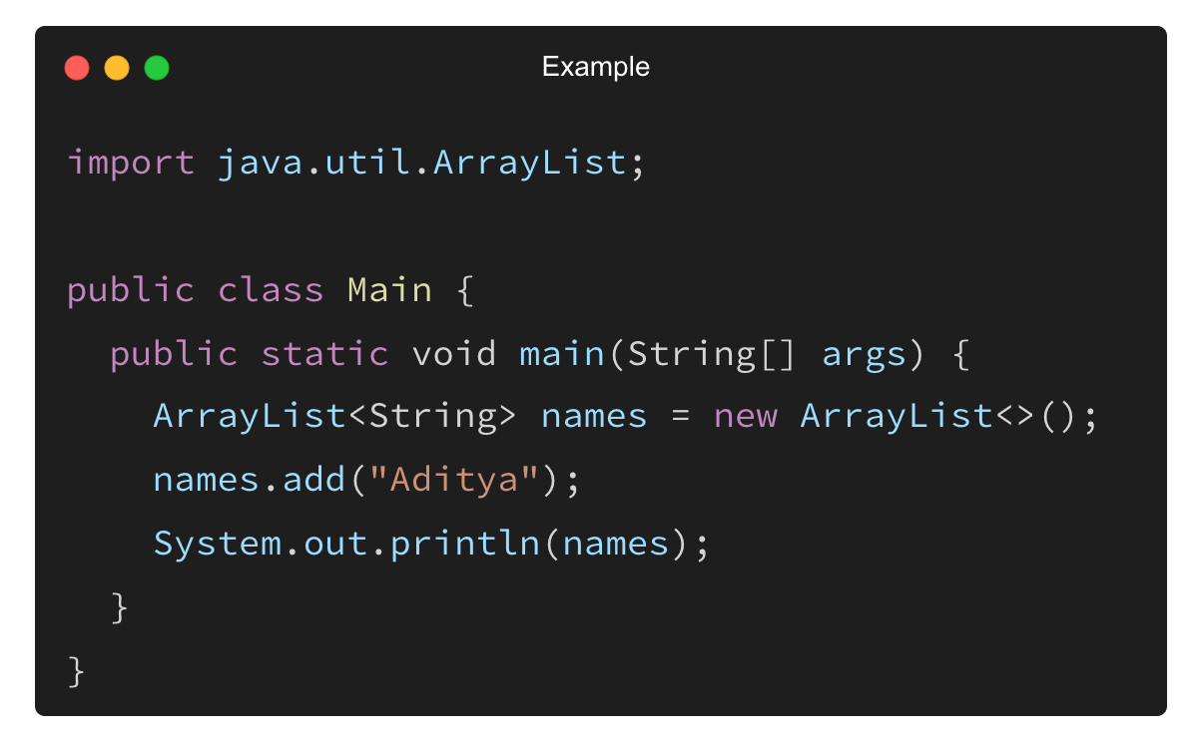
Importing Built-in Java Packages
Java provides built-in packages for commonly used classes.
Examples:
Package | Purpose
java.util | Data structures (ArrayList, HashMap)
java.io | File handling (File, BufferedReader)
java.sql | Database operations (Connection, ResultSet)
java.time | Date & time (LocalDate, Instant)

Slide 10
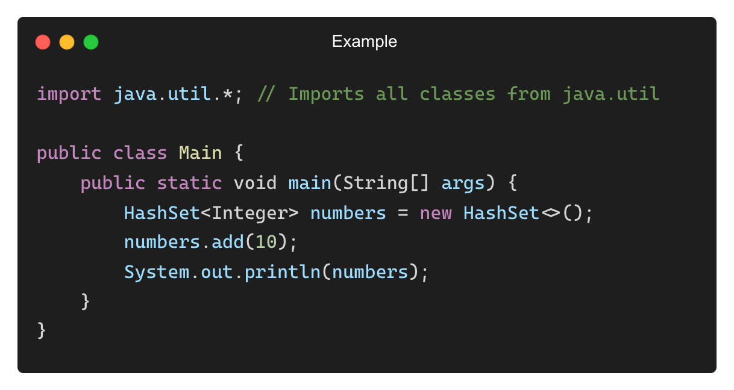
Importing an Entire Package (*)
Instead of importing individual classes, you can import an entire package.
✅ Pros: No need to list every class separately.
❌ Cons: Might slow down compilation if unused classes are imported.

Slide 11
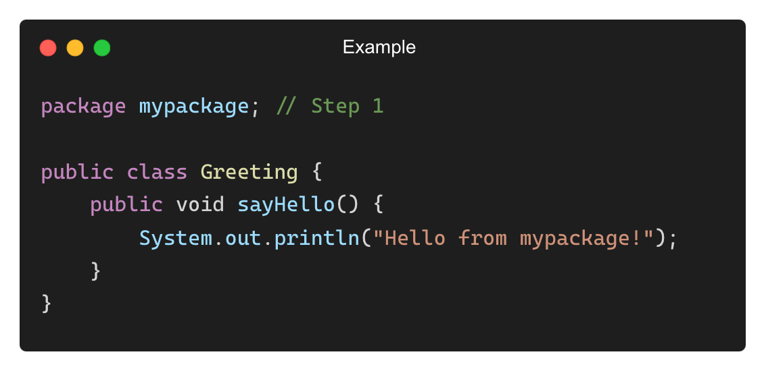
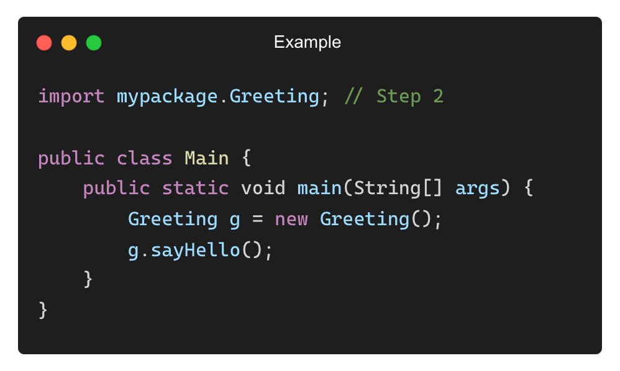
Importing User-Defined Packages
Steps:
Create a package
Define a class inside the package
Import and use the class in another program
Example (Creating Package mypackage):
Using the Package in Another Class:
Output:
Hello from mypackage!

Slide 12
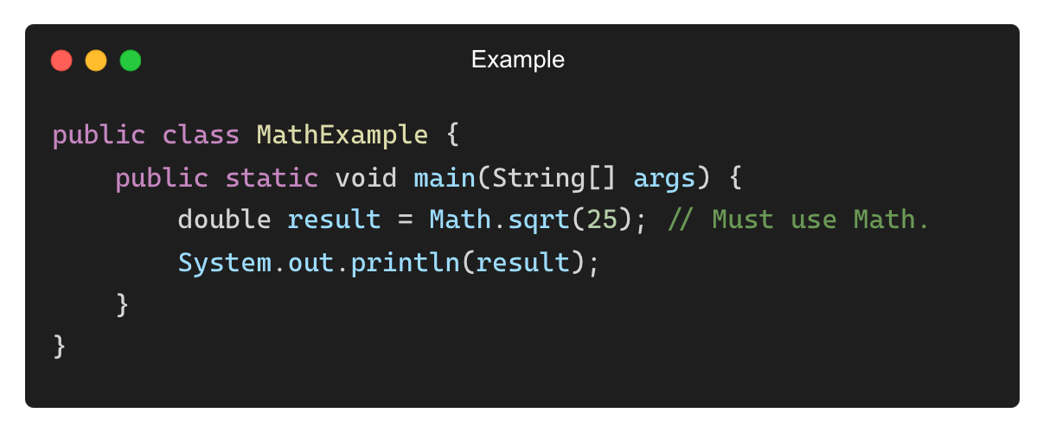
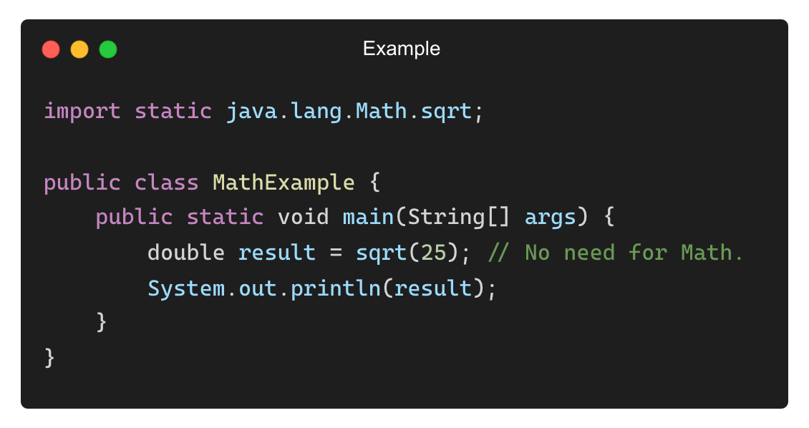
Static Import in Java
static import allows you to access static members (methods/variables) without class names.
Example (Without Static Import):
Example (With Static Import):
Output:
5.0

Slide 13
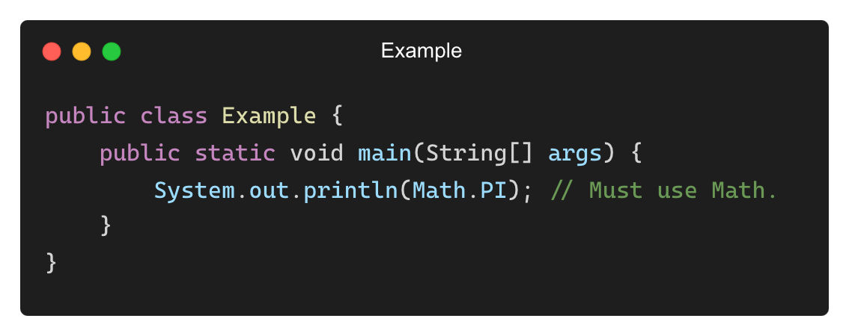
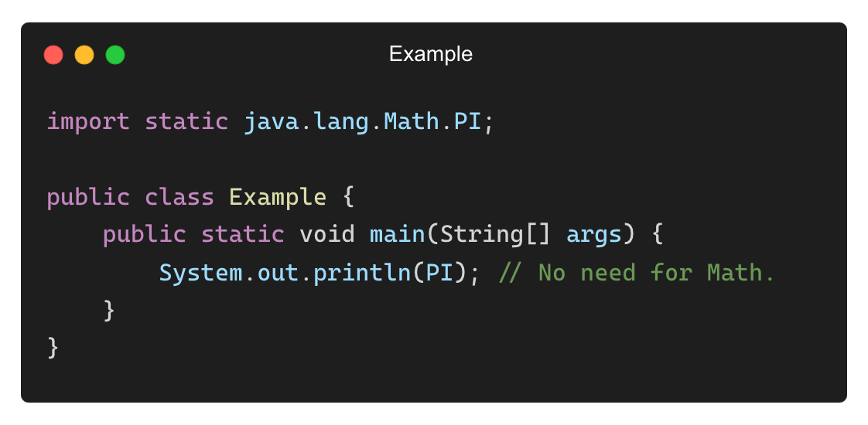
Using Static Import for Constants
Example (Without Static Import):
Example (With Static Import):
Output:
3.141592653589793

Slide 14
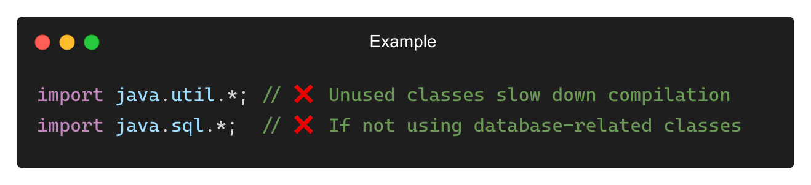
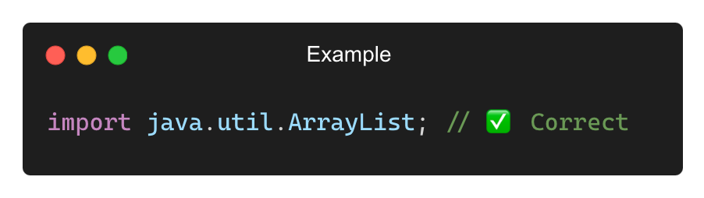
Common Mistakes with Importing
❌ Importing Unnecessary Packages
✅ Solution: Import only what is needed.

Slide 15
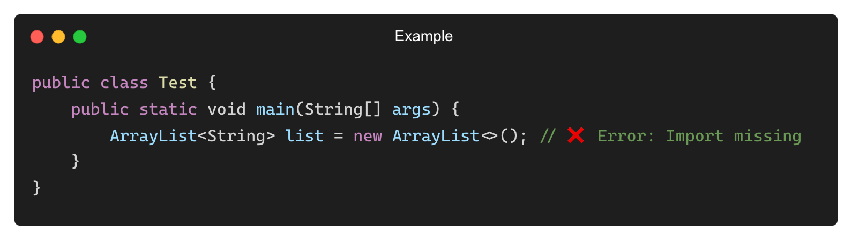
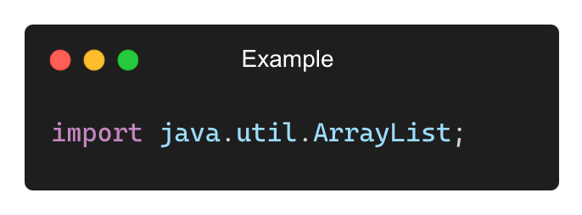
Common Mistakes with Importing (Contd.)
❌ Forgetting to Import Required Classes
✅ Solution: Import the required class.

Slide 16
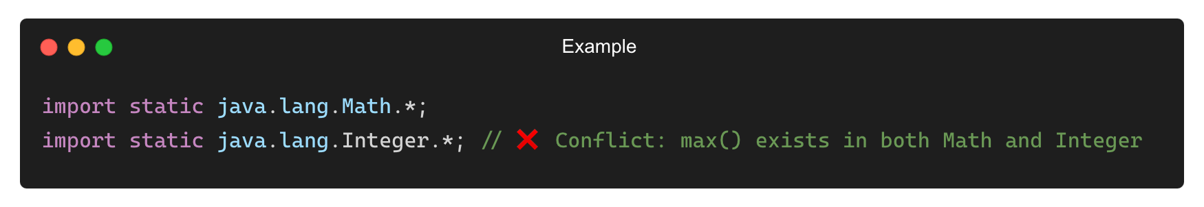
Common Mistakes with Importing (Contd.)
❌ Overusing Static Imports (Causing Naming Conflicts)
✅ Solution: Avoid excessive static imports when conflicts may arise.

Slide 17
THANK YOU

